Slide 1
Binomial Trees
A binomial heap is a collection of binomial trees.
The binomial tree B_{k} is an ordered tree defined recursively
B_{o} Consists of a single node
.
.
.
B_{k} Consists of two binominal trees B_{k-1} linked together. Root of one is the leftmost child of the root of the other.

Slide 2
Binomial Trees
B _{k-1}
B _{k-1}
B _{k}

Slide 3
Binomial Trees
B₂
B₁
B₁
B₀
B₁
B₀
B₁
B₂
B₃
B₃
B₂
B₀
B₁
B₄

Slide 4
Binomial Trees
B_{k-2}
B₁
Bo
B₂
B_{k-1}
B_{k}

Slide 5
Properties of Binomial Trees (Cont.)
B_{k-3}
B₁
B₀
B₂
B_{k-2}
B_{k-3}
B₁
B₀
B₂
B_{k-2}
B_{k-1}

Slide 6
Binomial Heaps
A BINOMIAL HEAP H is a set of BINOMIAL
TREES that satisfies the following “Binomial
Heap Properties”
Each binomial tree in H is HEAP-ORDERED
the key of a node is ≥ the key of the parent
Root of each binomial tree in H contains the smallest key in that tree.

Slide 7
Binomial Heaps
Example: A binomial heap with n = 13 nodes
3 2 1 0
13 =< 1, 1, 0, 1>₂
Consists of B₀, B₂, B₃
head[H]
10
1
6
B₀
12
25
8
14
29
B₂
18
11
17
38
B₃
27

Slide 8
Representation of Binomial Heaps
Each binomial tree within a binomial heap is stored in the left-child, right-sibling representation
Each node X contains POINTERS
p[x] to its parent
child[x] to its leftmost child
sibling[x] to its immediately right sibling
Each node X also contains the field degree[x] which denotes the number of children of X.

Slide 9
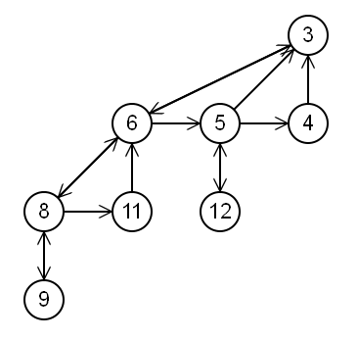
Links
The typical method of implementing the links between nodes is to have pointers to a parent, sibling and child.
A tree does not have a direct link to all it’s immediate children, instead it goes to its first child and then iterates through each sibling.
Here is an illustration of the regular pointer structure for a binomial tree.

Slide 10
Representation of Binomial Heaps
HEAD [H]
10
10
ROOT LIST (LINKED LIST)
10
10
10
10
parent
key
10
10
10
10
10
degree
10
10
10
10
10
child
10
sibling
10
10
10
10
10
10
10
10

Slide 11
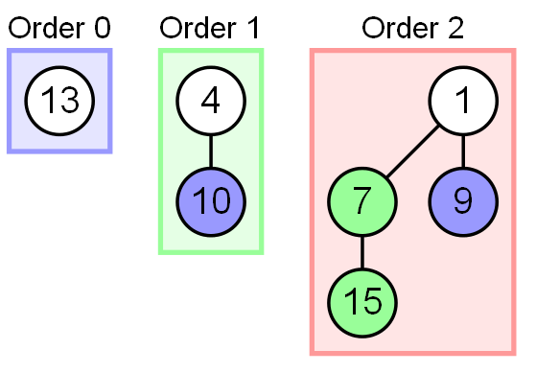
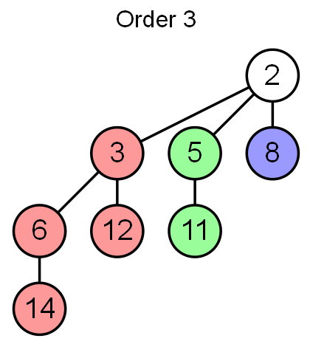

Slide 12
Operations
Union
The union operation merges the two heaps together by continually linking trees of the same order until no two trees of the same order exist.
Given two Binomial Heaps H1 and H2, union(H1, H2) creates a single Binomial Heap.
1) The first step is to simply merge the two Heaps in non-decreasing order of degrees.
2) After the simple merge, we need to make sure that there is at-most one Binomial Tree of any order. To do this, we need to combine Binomial Trees of same order. We traverse the list of merged roots, we keep track of three pointers, prev, x and next-x. There can be following 4 cases when we traverse the list of roots.

Slide 13
Case 1: Orders of x and next-x are not same, we simply move ahead.
In following 3 cases orders of x and next-x are same.
Case 2: If order of next-next-x is also same, move ahead.
Case 3: If key of x is smaller than or equal to key of next-x, then make next-x as a child of x by linking it with x.
Case 4: If key of x is greater, then make x as child of next.

Slide 14
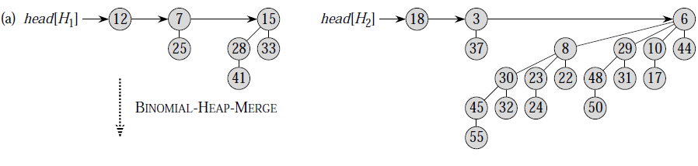
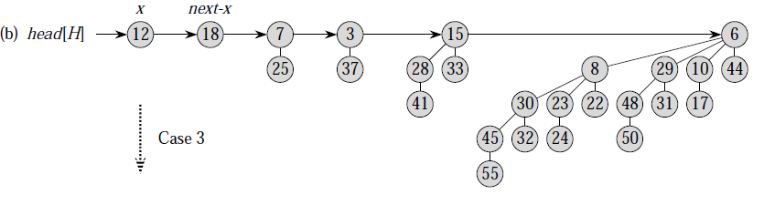

Slide 15
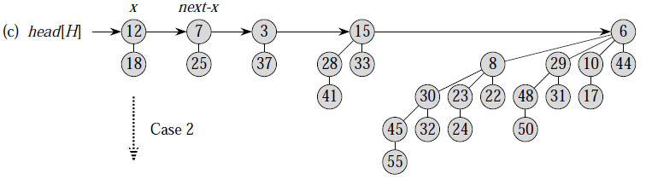
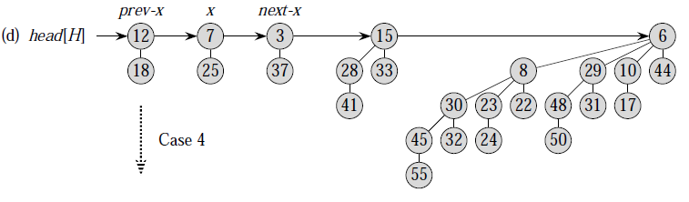

Slide 16
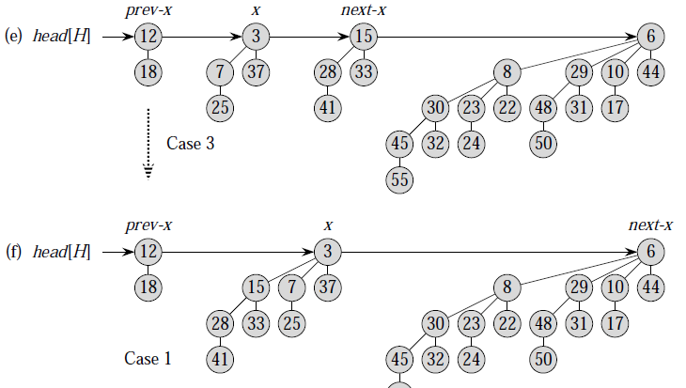


Slide 17
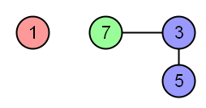
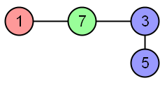
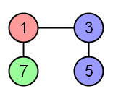
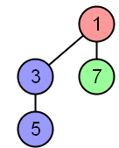

Slide 18
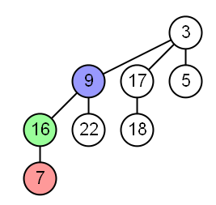
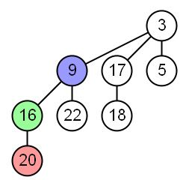
Decrease key
Decrease key reduces the specified node’s key and then bubbles it up through its ancestors until the tree meets the conditions of a heap.
20 decreases to 7
7 < 16(parent)

Slide 19
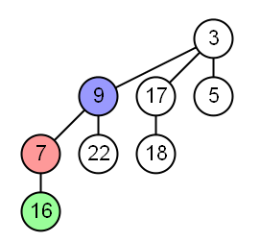
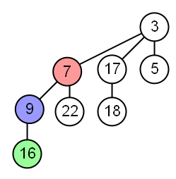
7 < 9(parent)

Slide 20
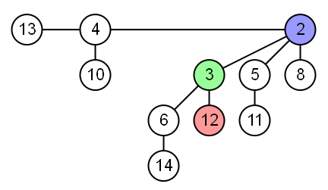
Delete
Delete is performed by calling decrease key to reducing the node to negative infinity which pulls the node to the top of the tree.
Delete 12

Slide 21
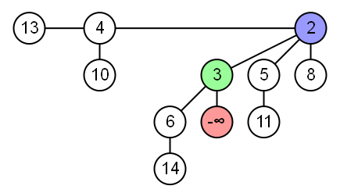
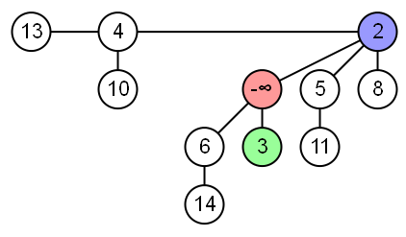

Slide 22
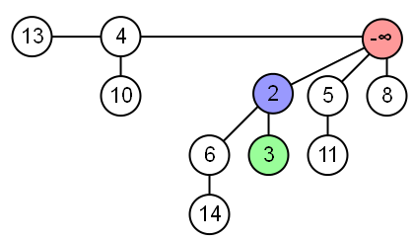
The tree is then detached from the rest of the heap and the node removed. The fragments of the old tree are reversed and linked together to form a new heap.

Slide 23
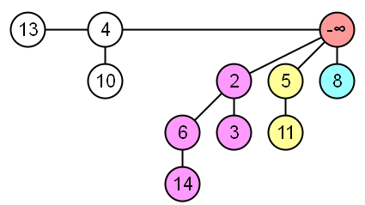
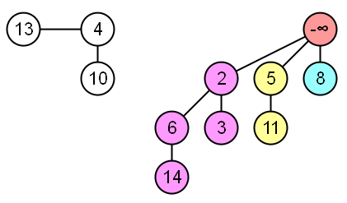

Slide 24
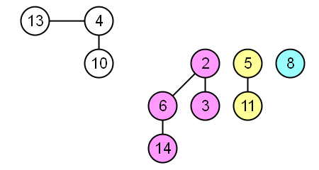
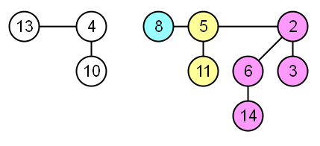
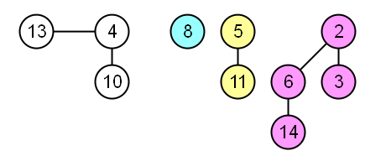
The two heaps can then be combined using the union operation.

Slide 25
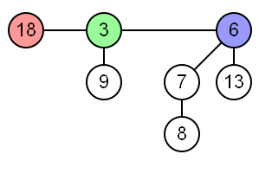
Find minimum
Find minimum iterates through the roots of each binomial tree in the heap.

Slide 26
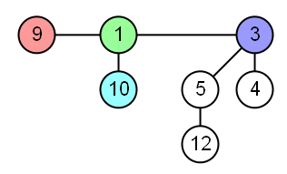
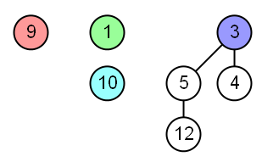
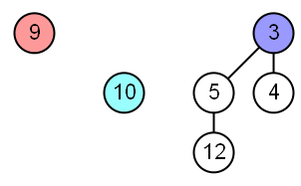
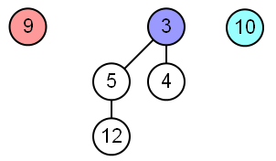
Extract minimum
Extract minimum iterates through the roots of each binomial tree in the heap to find the smallest node which is removed. The tree fragments are then reversed to form another heap.

Slide 27
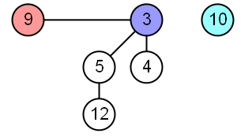
The two heaps can then be combined using the union operation.

Slide 28
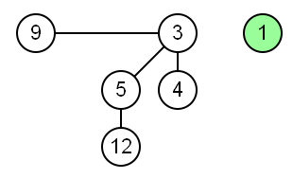
Insert
Insert creates a new heap with the inserted element which are then combined using the union operation.
MAKE-BINOMIAL-HEAP ( )
allocate H
head [ H ] ← NIL
return H
end
RUNNING-TIME= Θ(1)

Slide 29
Complexity
Operation | Description | Complexity
Decrease key | Decreases an existing key to some value | Θ(logn)
Delete | Deletes a node given a reference to the node | Θ(logn
Extract minimum | Removes and returns the minimum value given a reference to the node | Θ(logn)
Find minimum | Returns the minimum value | O(logn)*
Insert | Inserts a new value | O(logn)
Union | Combine the heap with another to form a valid binomial heap | Θ(logn)**
* This can be reduced to Θ(1) by maintaining a pointer to the minimum element ** Where n is the size of the larger heap

